Slide 1
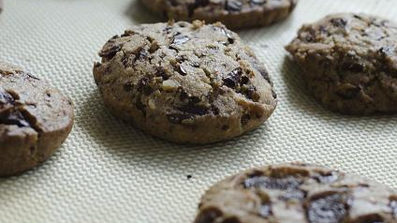
Sessions Cookies Authentication
Michal Špaček https://www.michalspacek.cz

Slide 2

Identification
I'm Jack

Slide 3
Authentication
I'm Jack
AND
I can prove it with this password (I can authenticate myself)
BTW, not authentification

Slide 4
Authorization
I'm Jack
AND
I can prove it with this password (I can authenticate myself)
AND
I'm allowed to this and that (I'm authorized)

Slide 5
Login and Register form
<input type=text name=email>
<input type=password name=password>

Slide 6
Passwords
Hashing before storing
Hash function One-way function, "password imprint"
Hashing is not encryption Encryption is two-way

Slide 7
Password hashing with bcrypt
password_hash($_POST['password'], PASSWORD_DEFAULT);
password_verify($_POST['password'], $dbpassword);

Slide 8
ALWAYS password_hash()

Slide 9
ALWAYS password_hash()
OTHERWISE YOU'RE F.U.C.K.E.D. (and your users too)

Slide 10
Sessions
HTTP is stateless Sessions are a workaround

Slide 11
Sessions in PHP
session_start(); Start a session, generate a cookie with session id
$_SESSION['variablename'] = 'a value'; Store a value
echo $_SESSION['variablename']; Fetch a value

Slide 12
Sign-in with sessions
Verify password password_verify($_POST['password'], $dbpassword);
Generate new session id session_regenerate_id();
Start session session_start();
Store signed-in username $_SESSION['username'] = $_POST['username'];

Slide 13
Sign-out
$_SESSION = array();

Slide 14
Session security
After successful password verification session_regenerate_id();
Configuration session.cookie_httponly On
session.save_path unique per app
session.use_only_cookies On

Slide 15
HTTP Cookies
Data from server stored in the browser using HTTP headers
Possible to edit cookies in the browser F12 tools in Firefox, Edit This Cookie for Chrome

Slide 16
Setting cookies
setcookie('cookiename', 'cookie value', time() + 86400); Expires in 1 day
setcookie('cookiename', 'cookie value', 0); Expires when the browser is closed, so called session cookie

Slide 17
Reading cookies
$_COOKIE Super-global array
$_COOKIE['cookiename']; Value of cookiename cookie

Slide 18
Deleting cookies
setcookie('cookiename', 'cookie value', time() - 3600);
Session cookies Don't care

Slide 19
Cookies do's and don'ts
DO Set cookies before any output (otherwise headers already sent error)
DON'T Put usernames in cookies Put other secret data Otherwise you're

